Slide 1

ICIP 2023
Fibonet: A Light-weight and Efficient
Neural Network for Image Segmentation
Ruohao Wu | Xi Xiao | Guangwu Hu
Hanqing Zhao | Han Zhang | Yongqing Peng

Slide 2

CONTENTS
01
Introduction
02
Related Work
03
Our Approach
04
Evaluation
05
Ablation study

Slide 3

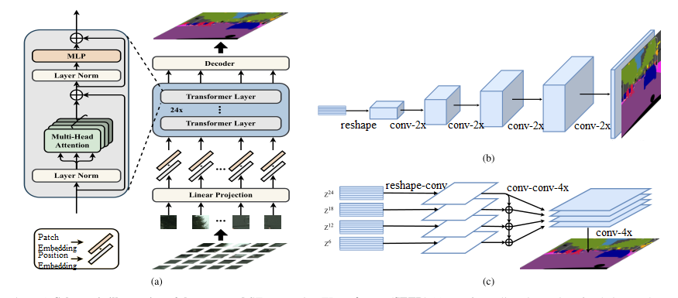
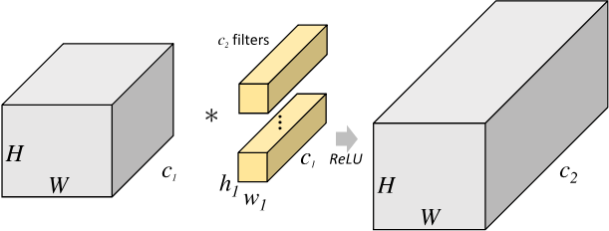
Introduction
Background & Problems
In recent years, accurate models for image segmentation have become larger and more complex. However, it is hard to apply them into embedded devices which usually have limited space for data, energy and computing. Meanwhile, since many embedded devices do not support modifications of computing units, simple models with such requirements cannot be adapted to these devices. To achieve high accuracy for image segmentation in embedded devices, we propose a light-weight and efficient neural network, named Fibonet.

Slide 4
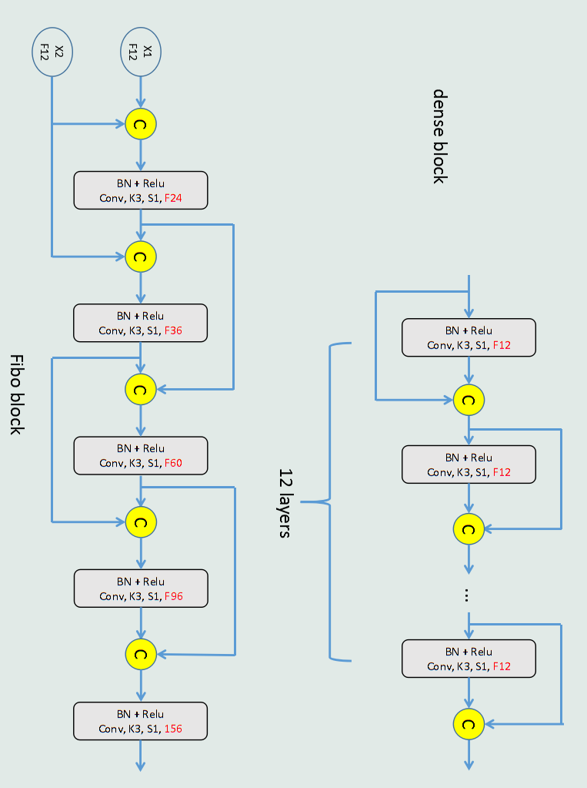
Introduction
Contributions
We propose Fibonet which is light-weight and efficient. In particular, we also propose the stage loss function to train the models.
We apply the model to embedded devices based on low_x0002_light image sensors to achieve real-time small object segmentation.
We compare with many other models and prove that it effectively balances accuracy and computing resources.

Slide 5
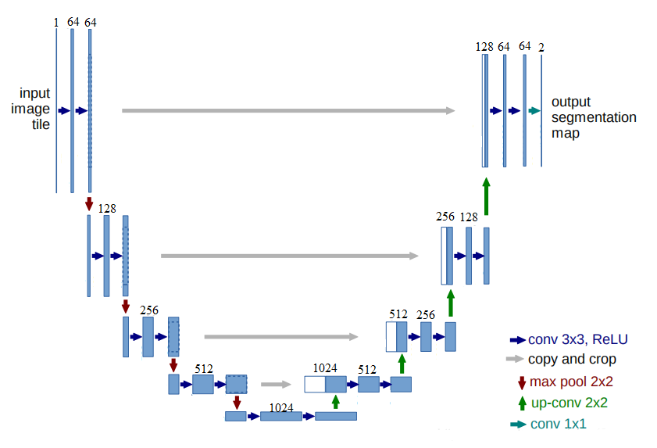
Related Work
Image Segmentation
FCN first proposed an image segmentation neural network that only uses convolutional layers and up-sampling or down-sampling operations.
The residual connection used was proposed in Resnet in 2016.
Unet further improved the segmentation effect by adding multi-scale fusion. Its classic structure and good generalization make it still widely used in medical imaging.

Slide 6
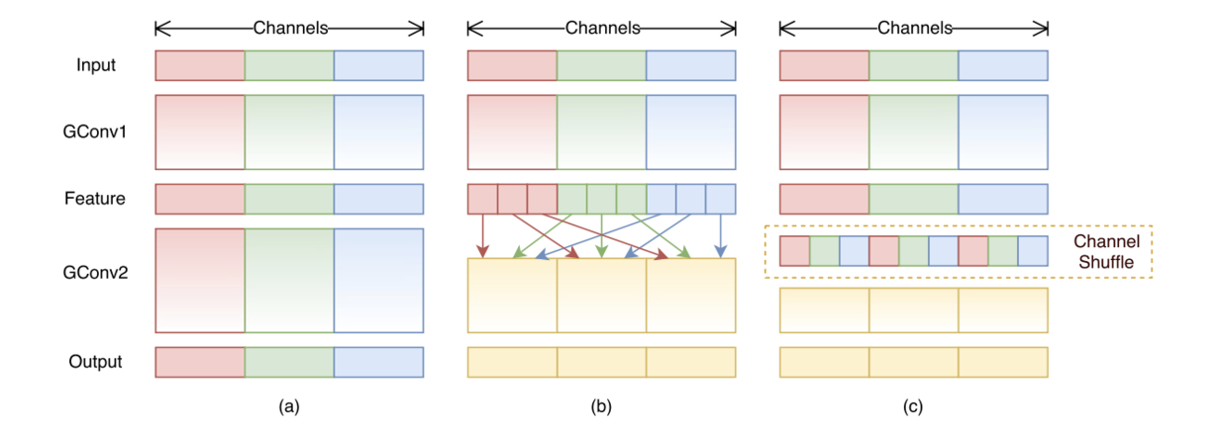
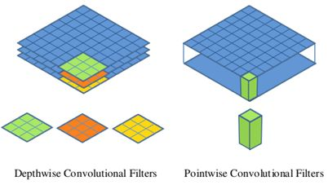
Related Work
MobileNet
It used depthwise separable convolution to greatly reduce the complexity of convolution calculations.
ShuffleNet
Light-weight Networks
It enhances the robustness of the model by shuffling the channels randomly.
These models require the support of underlying hardware in practical applications.

Slide 7
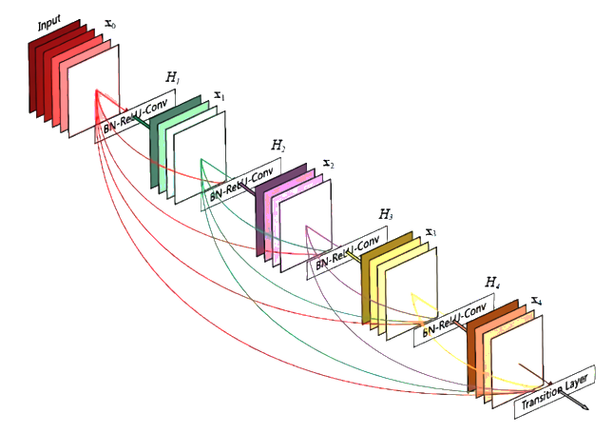
Related Work
DenseNet
Densenet proposed the idea of feature multiplexing that takes input of each convolutional layer as the output of all previous convolutional layers.
The input of each convolutional layer in the traditional Denseblock is the combination of the input and output of the previous convolutional layer.
As the output set of all convolutional layers, and the output channel number of each convolutional layer is fixed.

Slide 8
Our Approach
Model Overview
The overall process can be divided into three steps:
Constructing the dataset using the original low-light video
Training the CNN model
Applying it to our embedded device

Slide 9
Our Approach
Fibonacci Structure
Make more efficient use of parameters with hop connections and feature multiplexing. Without introducing additional cells and changing existing ones, good precision performance can be achieved with only a few parameters.

Slide 10
Our Approach
Fibonacci Structure
The input of each convolutional layer of Fiboblock is obtained by combining the outputs of the first two convolutional layers.
At the same time, the number of output channels and input channels of each convolutional layer maintain a fixed coefficient.
As the depth increases, the number of input channels and the number of output channels show a Fibonacci sequence increase.
The number of output channels of the entire block is the output of the last convolutional layer, which has an exponential relationship with the number of convolutional layers.

Slide 11
Our Approach
Fibonet for Segmentation
Fibonet is constructed by cascading two Fiboblocks, with the Fibonacci structure which adjusts the combination of basic computing units through skip connections and feature reusing so that it is less computationally intensive and dataset-demanding.

Slide 12
Evaluation
Visual effects
Visually, our model is the closest to reality, especially in details such as small targets and edges.

Slide 13
Evaluation
Accuracy
 | mIoU | mIoU_s | mIoU_m | mIoU_l | Size (MB) | Parameters (M)
Densenet | 0.457 | 0.44 | 0.704 | 0.882 | 0.284 | 0.0652
Resnet18 | 0.481 | 0.457 | 0.747 | 0.892 | 10.8 | 2.82
Deeplabv3+ | 0.412 | 0.362 | 0.621 | 0.778 | 63.5 | 16.6
Unet | 0.532 | 0.506 | 0.827 | 0.927 | 17.7 | 4.53
PSPnet | 0.379 | 0.355 | 0.643 | 0.831 | 48.2 | 12.6
Mobilenet V1 | 0.478 | 0.441 | 0.763 | 0.863 | 6.36 | 1.64
Mobilenet V2 | 0.477 | 0.437 | 0.749 | 0.859 | 5.35 | 1.34
Shufflenet V1 | 0.477 | 0.438 | 0.755 | 0.851 | 3.37 | 1.67
Shufflenet V2 | 0.483 | 0.452 | 0.761 | 0.862 | 3.54 | 1.74
Mobile-Unet | 0.531 | 0.498 | 0.825 | 0.919 | 4.96 | 1.24
Fibonet (ours) | 0.533 | 0.509 | 0.822 | 0.924 | 1.72 | 0.441
The experimental results show that our models are better or closer to other models in the accuracy indicator mIoU, and are much smaller than models with similar accuracy in size and amount of parameters.

Slide 14
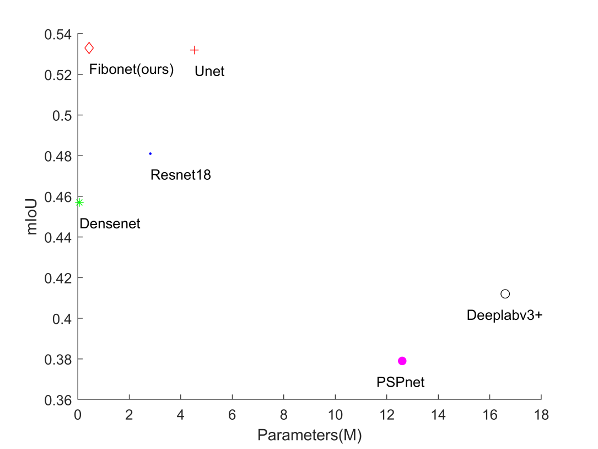
Evaluation
Parmeters/accuracy trade-off
The closer the model is to the left side of the picture, the fewer parameters. The closer the model above the image, the better the segmentation result, that is, the higher the segmentation accuracy. Fibonet is still closer to the top left, which means that the model in this paper is superior to all other classical segmentation models in terms of accuracy and number of parameters.

Slide 15
Ablation study
Fiboblock
Blocks | mIoU
Fiboblock+Fiboblock | 0.521
Fiboblock+Denseblock | 0.492
Denseblock+Fiboblock | 0.459
Denseblock+Denseblock | 0.457
The ablation study for Fiboblock is performed by replacing it with Denseblock, which is a structure commonly found in segmentation networks.
The reason why Fiboblock performs better than Denseblock is α, the ratio of input channels and output channels. The number of output channels of each convolutional layer in Denseblock is fixed. As the input channels grow, its α decreases rapidly.

Slide 16
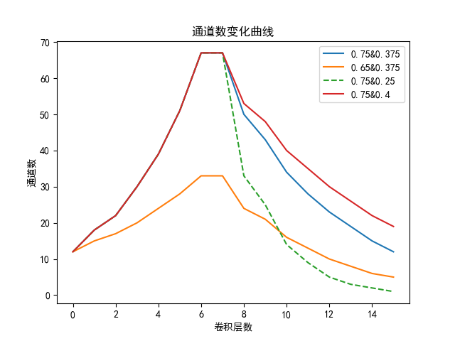
Ablation study
Fiboblock
Generally speaking, with the same number of layers, a larger α brings a larger number of feature maps. If the model extracts features better, the corresponding accuracy is higher.
For the impact of the ratio of input and output channels, we use a direct analogy by adjusting the α of two Fiboblocks.
α of Fiboblock1 | α of Fiboblock2 | mIoU
0.75 | 0.375 | 0.533
0.65 | 0.375 | 0.474
0.75 | 0.25 | 0.506
0.75 | 0.4 | 0.533

Slide 17
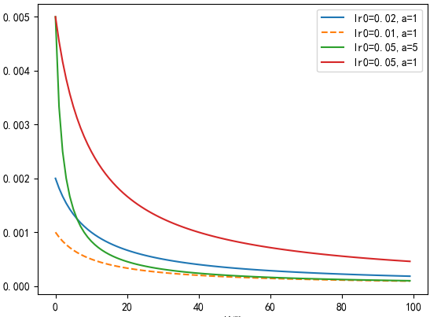
Ablation study
Learning Rate
Parameters | Train mIoU | Test mIoU
lr₀=0.02, a=1, t=10 | 0.543 | 0.533
lr₀=0.01, a=1, t=10 | 0.542 | 0.531
lr₀=0.05, a=5, t=10 | 0.504 | 0.496
lr₀=0.05, a=1, t=10 | 0.543 | 0.532
To take advantage of the characteristics of different learning rates in different training stages, we also use the method in Equation to make the learning rate transition smoothly. Since it is appropriate to reduce the learning rate to one-tenth, we adopt different initial learning rates to set different dynamic ranges.

Slide 18

Q&A
Thank you for listening

